Slide 1
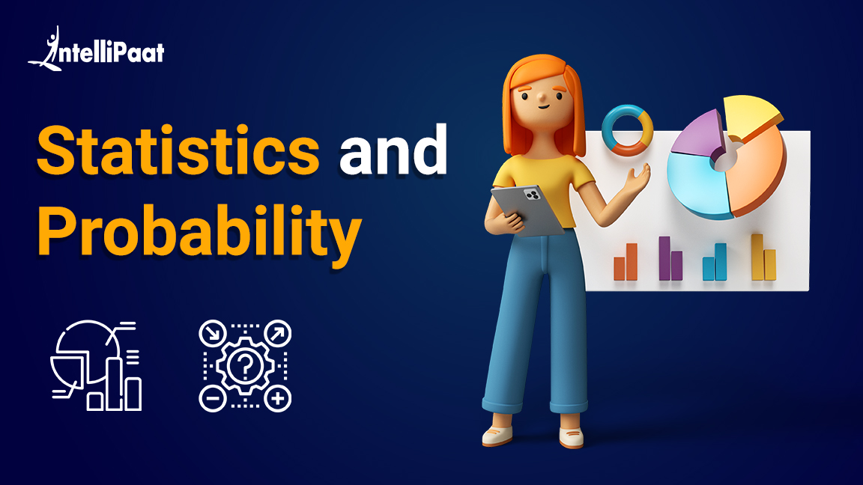

Slide 2

01
02
Intro to Statistics
Sampling
03
04
Central Tendencies
Variation
05
Correlation
06
Importance of Tables and charts
07
08
Probability in Business Analytics
And Distribution
Probability
09
Hypothesis Testing , Estimation
And Goodness of Fit

Slide 3

Introduction to Statistics

Slide 4

What is Statistics?

Slide 5


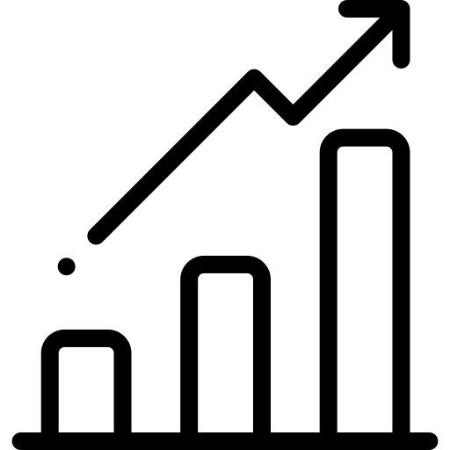
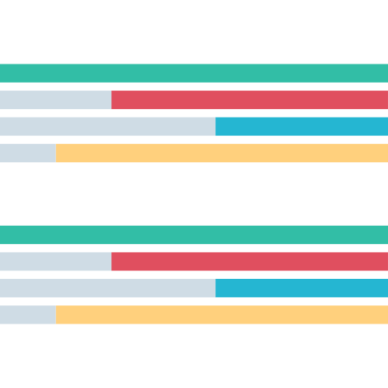
What is Statistics?
Statistics is a branch of Mathematics that deals with collection, analyzing, and interpreting large amounts of data.

Slide 6

Why is Statistics important?

Slide 7
Why is Statistics important?
Statistics allows us to derive knowledge from large datasets and this knowledge can then be used to make predictions, decisions, classifications etc.

Slide 8

Where is Statistics used?

Slide 9




Where is Statistics used?
Statistics are used in various fields, some of them are:
Medical Research
Stock Market
Sales Projection
Weather Forecasting

Slide 10

Sampling

Slide 11



Sampling
Sampling is the process of collecting data to perform analysis on

Slide 12

Sample vs Population

Slide 13
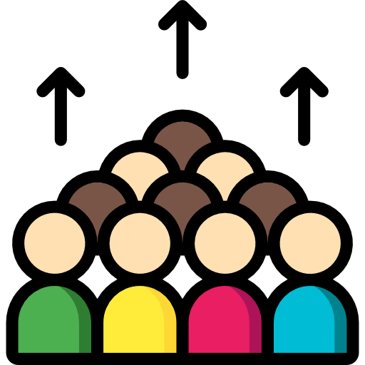


Sample vs Population
Population is the entire dataset such as the whole population of a country, Sample is subset of that population which is analyzed to make inferences

Slide 14

Random Sampling

Slide 15



Random Sampling
Random Sampling is the process of selecting a subset / sample from a population in such a way that every data point is equally likely to be included in the sample

Slide 16
Stratified Sampling

Slide 17
Stratified Sampling
Stratified Sampling is the process of dividing your samples into layers or groups and then performing random sampling for each group

Slide 18

Central Tendencies

Slide 19
Central Tendencies
Central Tendency is used to indicate where does the middle or center of the distribution of our data lies

Slide 20

Mean

Slide 21

Mean
Mean is the average of the data. In simpler terms it’s the sum of values divided by total number of values. It’s represented by Greek letter Sigma
Mean

Slide 22

Mode

Slide 23

Mode
Mode is used to indicate the most frequent data point, in other words the one which occurs most number of times
Mode

Slide 24
Median

Slide 25

Median
Median is the middle of the data. If the data is arranged in ascending order then the data element which occurs right at the center is the median
Median

Slide 26

Variation

Slide 27



Variation
Variation in statistics is used to show how data is dispersed, or spread out. Several measures of variation are used in statistics.
Range
Quartiles
Variance

Slide 28

Range

Slide 29
Range
Range is the difference between the highest and the lowest values in our dataset. Range tells us the distance between the lowest and highest values in our data

Slide 30

Percentiles

Slide 31
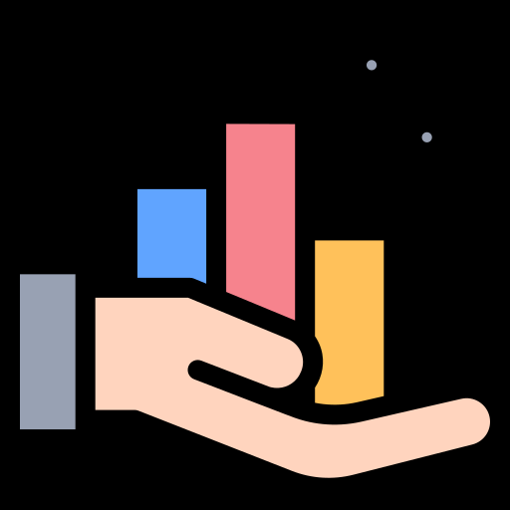
Percentiles
Percentiles are scores that are used to describe a value below which some Observations fall.
E.g.: If X is at 70th Percentile it mean 70% of other data points from our sample are below X

Slide 32

Quartiles

Slide 33

Quartiles
Quartiles are used to break the data into 4 parts so as to better find the spread of data in a way that is less influenced by outliers.
Quartiles are expressed in percentiles. 1st Quartile is 25th Percentile, 2nd Quartile is 50th Percentile (Median) and 3rd Quartile is 75th Percentile

Slide 34
Interquartile Range (IQR)

Slide 35
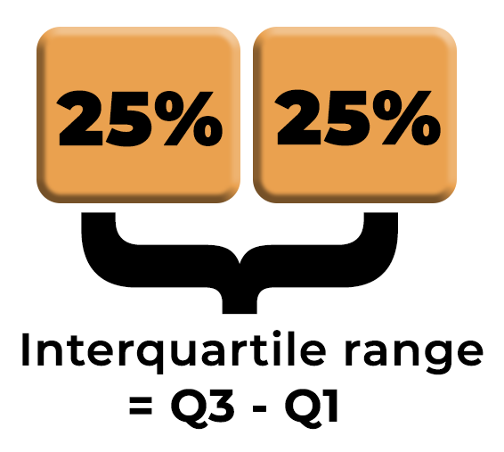
Interquartile Range (IQR)
Interquartile Range (IQR) is the difference between the lower and upper quartile. This gives us a better idea of the range of data.

Slide 36

Standard Variance and Standard Deviation

Slide 37
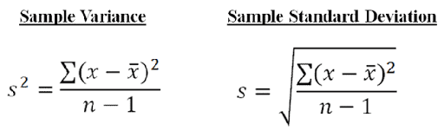
Standard Variance and Standard Deviation
Standard Variance measures how far a set of numbers are spread out from their average value.
Standard Deviation is used to express the magnitude by which the members of a group differ from the mean value for the group.
Standard Deviation is the square root of Standard Variance.

Slide 38

Correlation

Slide 39
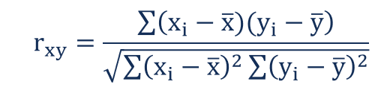
Correlation
Correlation is a term that is a measure of the strength of a linear relationship between two quantitative variables

Slide 40

Positive Correlation

Slide 41

Positive Correlation
Positive Correlation is a term that is used to describe a positive linear relationship between two quantitative variables
Positive Correlation

Slide 42

No Correlation

Slide 43
No Correlation
No Correlation is a term used to describe no linear relationship between two quantitative variables
No Correlation

Slide 44

Negative Correlation

Slide 45
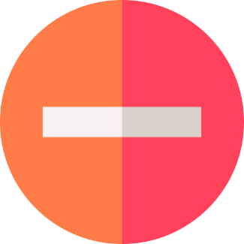
Negative Correlation
Negative Correlation is a term that is used to describe the strength of a Negative linear relationship between two quantitative variables
Negative Correlation

Slide 46

Tables

Slide 47
Tables
A way of presenting statistical data through a systematic arrangement of the numbers describing some mass phenomenon or process
A statistical table may be regarded as representing a subject and predicate. The meaning of each number is indicated by the headings of the corresponding row and column.

Slide 48
Charts

Slide 49
Charts
A statistical graph or chart is defined as the pictorial representation of statistical data in graphical form. The statistical graphs are used to represent a set of data to make it easier to understand and interpret statistical information.

Slide 50
Charts
A statistical graph or chart is defined as the pictorial representation of statistical data in graphical form. The statistical graphs are used to represent a set of data to make it easier to understand and interpret statistical information.
Lets list down the types of charts

Slide 51
Charts
A statistical graph or chart is defined as the pictorial representation of statistical data in graphical form. The statistical graphs are used to represent a set of data to make it easier to understand and interpret statistical information.
Lets list down the types of charts
Types Of Charts
1.Bar chart
2.Histogram
3.Pie chart
4.Box chart
5.Line Graph
6.Area plot
7.Scatter plot

Slide 52
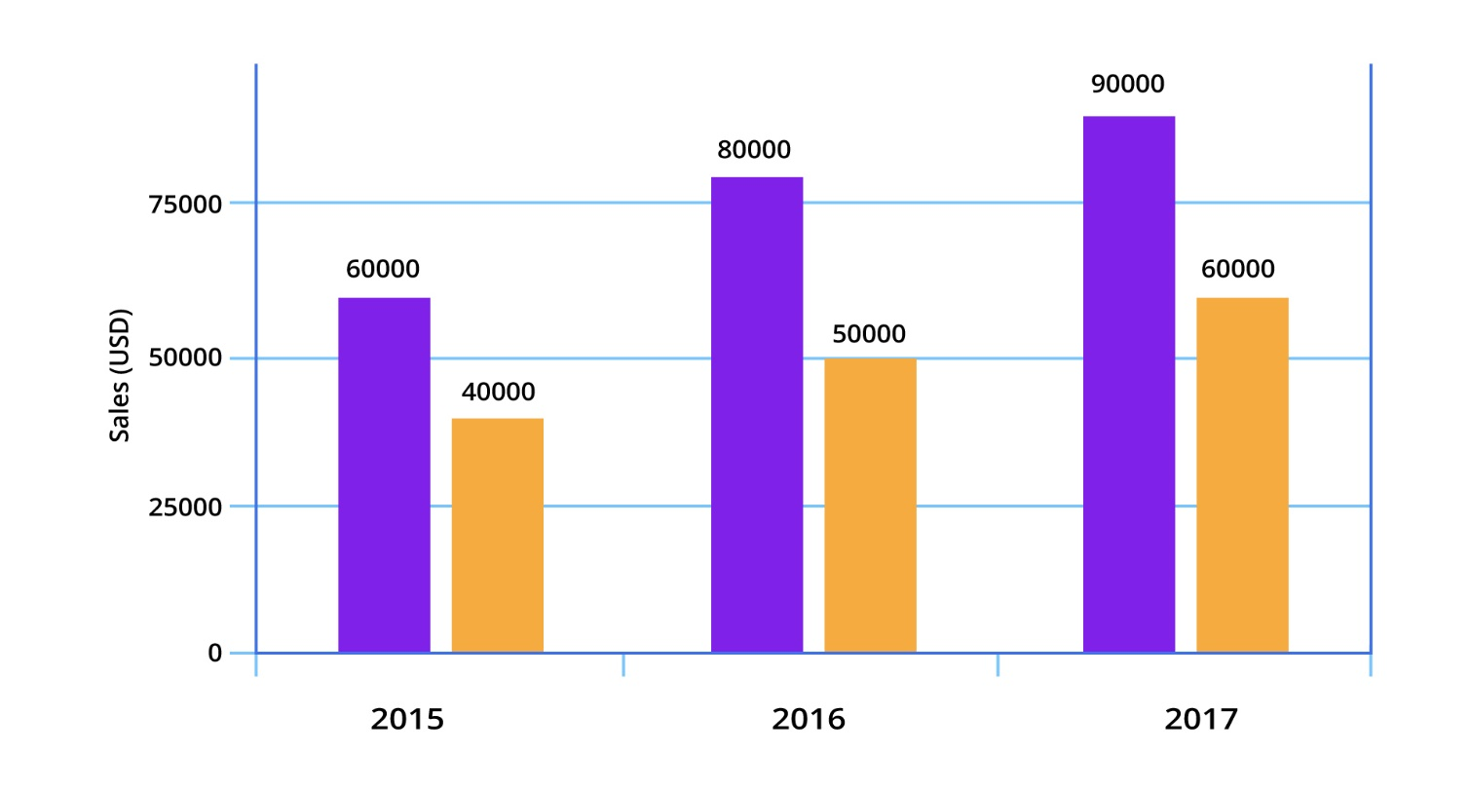
1. Bar chart
Bar charts are among the most frequently used chart types. As the name suggests a bar chart is composed of a series of bars illustrating a variable’s development. Given that bar charts are such a common chart type, people are generally familiar with them and can understand them easily

Slide 53
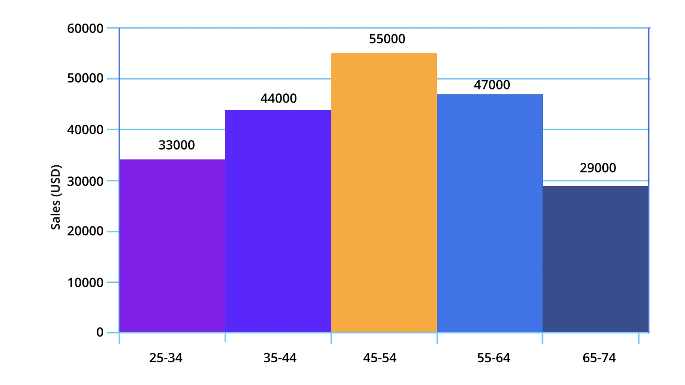
2. Histogram
A series of bins showing us the frequency of observations of a given variable. The definition of histogram charts is short and easy..

Slide 54
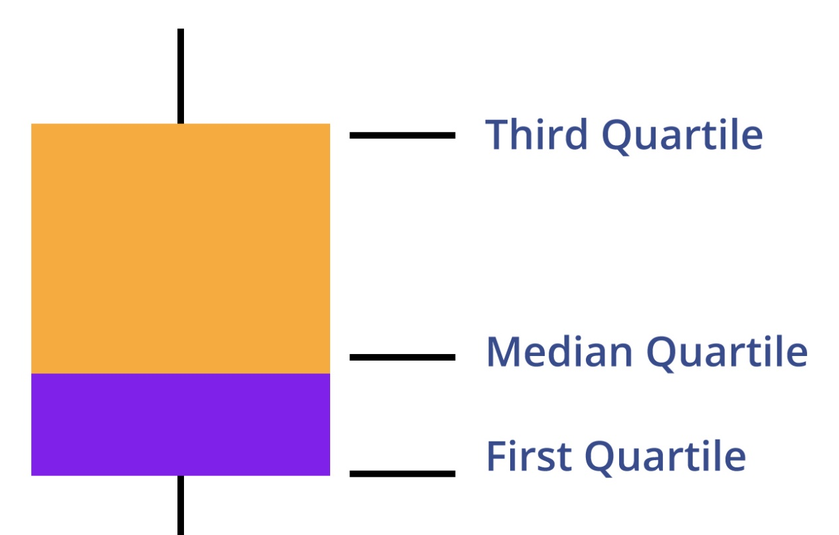
3. Box chart
Box plot, also called the box-and-whisker plot: a way to show the distribution of values based on the five-number summary: minimum, first quartile, median, third quartile, and maximum.

Slide 55
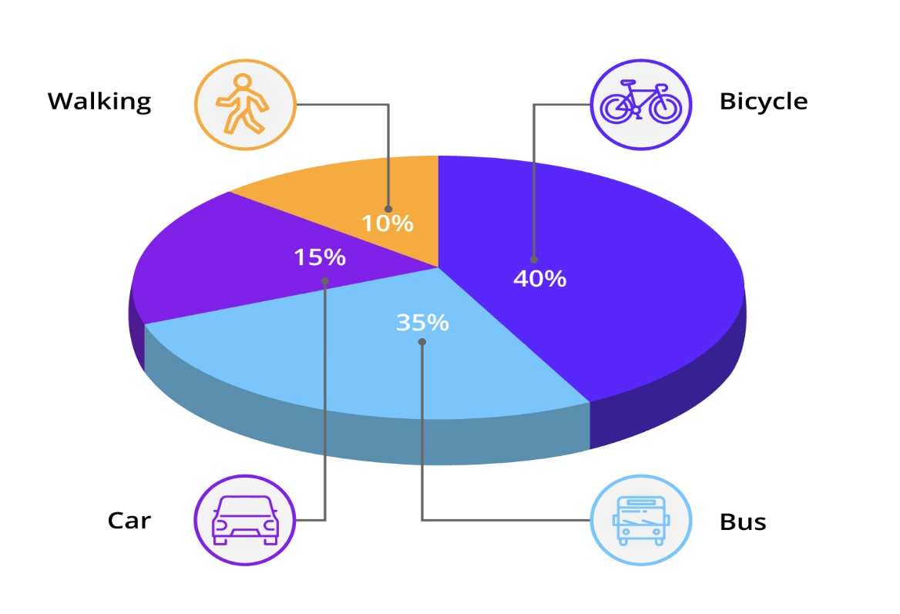
4. Pie chart
A pie chart is a circular graph divided into slices. The larger a slice is the bigger portion of the total quantity it represents.

Slide 56
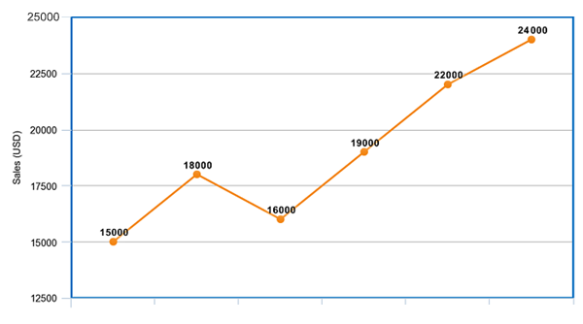
5. Line chart
A line chart is, as one can imagine, a line or multiple lines showing how single, or multiple variables develop over time. It is a great tool because we can easily highlight the magnitude of change of one or more variables over a period.

Slide 57
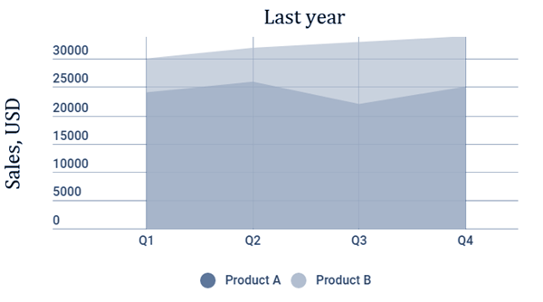
6. Area chart
Area charts are very similar to line charts. In fact, at first, I wanted to show them together. However, one major confusion could have arisen. So, please pay attention. The idea of an area chart is based on the line chart. Colored regions (areas) show us the development of each variable over time.

Slide 58
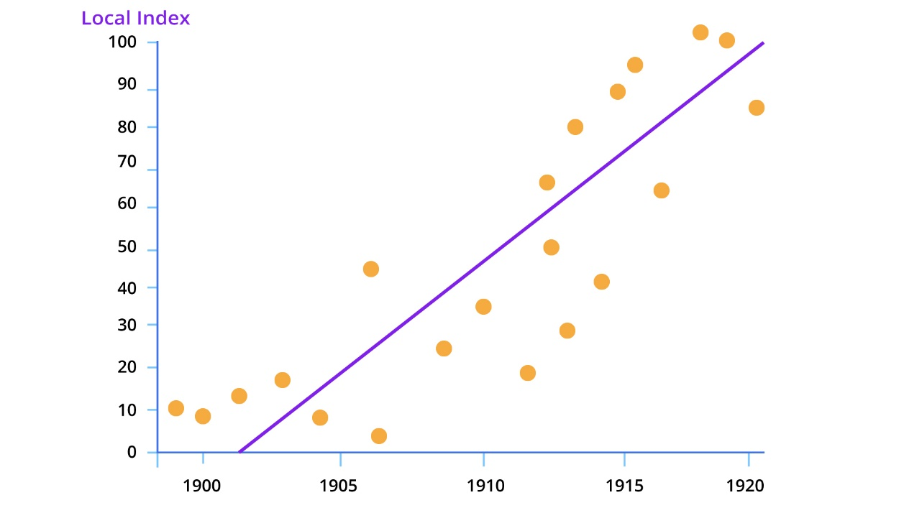
7. Scatter plot
A scatter plot is a type of chart that is often used in the fields of statistics and data science. It consists of multiple data points plotted across two axes. Each variable depicted in a scatter plot would have multiple observations. If a scatter plot includes more than two variables, then we would use different colors to signify that.

Slide 59

Probability

Slide 60
Introduction to Probability
Probability defines the likelihood of occurrence of an event

Slide 61
Introduction to Probability
Probability defines the likelihood of occurrence of an event
Probability can be defined as the ratio of the number of favorable outcomes to the total number of outcomes of an event.

Slide 62
Introduction to Probability
Probability defines the likelihood of occurrence of an event
Probability can be defined as the ratio of the number of favorable outcomes to the total number of outcomes of an event.

Slide 63
Probability
For an experiment having 'n' number of outcomes, the number of favorable outcomes can be denoted by x. The formula to calculate the probability of an event is as follows.
Probability(Event) = Favorable Outcomes
Total Outcomes

Slide 64

Business Analytics

Slide 65
Probability In Business Analytics
One practical use for probability distributions and scenario analysis in business is to predict future levels of requirements that could boost the economy of the company.

Slide 66
Probability In Business Analytics
One practical use for probability distributions and scenario analysis in business is to predict future levels of requirements that could boost the economy of the company.
Using a scenario analysis based on a probability distribution can help a company frame its possible future values in terms of a likely sales level and a worst-case and best-case scenario.

Slide 67

Probability

Slide 68
Probability Distribution
A probability distribution is a statistical function that describes all the possible values and likelihoods that a random variable can take within a given range.

Slide 69
Probability Distribution
A probability distribution is a statistical function that describes all the possible values and likelihoods that a random variable can take within a given range.
This range will be bounded between the minimum and maximum possible values, but precisely where the possible value is likely to be plotted on the probability distribution depends on a number of factors.

Slide 70
Binomial Distribution
A binomial distribution can be thought of as simply the probability of a SUCCESS or FAILURE outcome in an experiment or survey that is repeated multiple times. The binomial is a type of distribution that has two possible outcomes (the prefix “bi” means two, or twice)

Slide 71
Binomial Distribution
A binomial distribution can be thought of as simply the probability of a SUCCESS or FAILURE outcome in an experiment or survey that is repeated multiple times. The binomial is a type of distribution that has two possible outcomes (the prefix “bi” means two, or twice)
For example, a coin toss has only two possible outcomes: heads or tails and taking a test could have two possible outcomes: pass or fail.

Slide 72
Poisson Distribution
A Poisson distribution is a tool that helps to predict the probability of certain events happening when you know how often the event has occurred. It gives us the probability of a given number of events happening in a fixed interval of time.

Slide 73
Poisson Distribution
A Poisson distribution is a tool that helps to predict the probability of certain events happening when you know how often the event has occurred. It gives us the probability of a given number of events happening in a fixed interval of time.
A textbook store rents an average of 200 books every Saturday night. Using this data, you can predict the probability that more books will sell (perhaps 300 or 400) on the following Saturday nights

Slide 74
Normal Distribution
The normal distribution is a continuous probability distribution that is symmetrical on both sides of the mean, so the right side of the center is a mirror image of the left side.
The area under the normal distribution curve represents probability and the total area under the curve sums to one.

Slide 75
Normal Distribution
The normal distribution is a continuous probability distribution that is symmetrical on both sides of the mean, so the right side of the center is a mirror image of the left side.
The area under the normal distribution curve represents probability and the total area under the curve sums to one.
For example, if we randomly sampled 100 individuals we would expect to see a normal distribution frequency curve for many continuous variables, such as IQ, height, weight and blood pressure.

Slide 76
Hypothesis Testing and Estimation
Hypothesis testing refers to the process of making inferences or educated guesses about a particular parameter. This can either be done using statistics and sample data, or it can be done on the basis of an uncontrolled observational study.

Slide 77
Hypothesis Testing and Estimation
Hypothesis testing refers to the process of making inferences or educated guesses about a particular parameter. This can either be done using statistics and sample data, or it can be done on the basis of an uncontrolled observational study.
Estimation, in statistics, any of numerous procedures used to calculate the value of some property of a population from observations of a sample drawn from the population.

Slide 78
Goodness of Fit
The goodness-of-fit test is a statistical hypothesis test to see how well sample data fit a distribution from a population.
This test shows if your sample data represents the data you would expect to find in the actual population

Slide 79
Goodness of Fit
The goodness-of-fit test is a statistical hypothesis test to see how well sample data fit a distribution from a population.
his test shows if your sample data represents the data you would expect to find in the actual population
Goodness-of-fit establishes the discrepancy between the observed values and those that would be expected of the model in a normal distribution case.

Slide 80



India: +91-7847955955
US: 1-800-216-8930 (TOLL FREE)
sales@intellipaat.com
support@intellipaat.com
24/7 Chat with Our Course Advisor

